Slide 1

8. Object Design: Reusing Pattern Solutions

Slide 2
Outline
An overview of object design
Reuse
Design Patterns
Frameworks

Slide 3
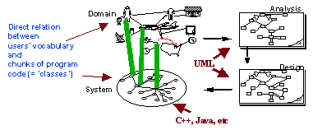
1. An Overview of Object Design
http://www.trireme.com/whitepapers/design/objects/object_oriented_design_what.html

Slide 4
1.1 Object Design
Object design is the process of adding details to the requirements analysis and making implementation decisions
The object designer must choose among different ways to implement the analysis model with the goal to minimize execution time, memory and other measures of cost.
Requirements Analysis:
Use cases, functional and dynamic model deliver operations for object model
Object Design:
Iterates on the models, in particular the object model and refine the models;
- Serves as the basis of implementation

Slide 5
1.2 Closing the Gap

Slide 6
1.3 Object Design Activities
Group of activities:
Reuse
Interface specification
Restructuring
Optimization
Notes:
Reuse: Off-the-shelf components identified during system design are used to help in the realization of each subsystem
Interface specification: The subsystem services identified during system design are specified in terms of class interfaces, including operations, arguments, type signatures, and exceptions.
Restructuring: Restructuring activities manipulate the system model to increase code reuse or meet other design goals
Optimization: Optimization activities address performance requirements of the system model.

Slide 7
Select Subsystem
Specification
Reuse
Identifying missing
Identifying components
attributes & operations
Specifying visibility
Adjusting components
Specifying types &
signatures
Identifying patterns
Specifying constraints
Specifying exceptions
Adjusting patterns

Slide 8
Check Use Cases
Restructuring
Optimization
Revisiting
Optimizing access
inheritance
paths
Collapsing classes
Caching complex
computations
Realizing associations
Delaying complex
computations

Slide 9
Examples of Object Design Activities
Identification of existing components
Full definition of associations
Full definition of classes:
System Design => Service,
Object Design => API
Specifying the contract for each component
Choosing algorithms and data structures
Identifying possibilities of reuse
Detection of solution-domain classes
Optimization
Increase of inheritance
Decision on control
(Re-)Packaging
Notes:
The analysis phase determines what the implementation must do (What), and the system design phase formulates the plan of attack (How), but on a very high level (namely subsystems, layers and partitions). The object design phase carries out the plan of attack!
It determines the full definitions of classes and associations used in the implementation, as well as the interfaces and the algorithms of the methods used to implement operations.
The objects discovered during the analysis can be thought of as the skeleton of the final system, but new classes are needed. In particular, the operations found during analysis must be expressed as algorithms, the classes, associations and attributes must be implemented with specific data structures. New objects will be identifed during this activity. For example, intermediate results might have to be stored to avoid the need for recompilation. This is an important issue if we implement a distributed system. Maps retrieved by the UI from the database should be stored locally, so not every access is an access across processor boundaries.
The object design phases therefore addresses any internal objects needed for the implementation and optimizes data structures and algorithms.
Object design is the basis of implementation.
Note that there is no change of notation, we are still using object models, functional models and dynamic models as our main weapons.

Slide 10
1. Reuse: Identification of existing solutions
Use of inheritance
Off-the-shelf components and additional solution objects
Design patterns
2. Interface specification
Describes precisely each class interface
3. Object model restructuring
Transforms the object design model to improve its understandability and extensibility
4. Object model optimization
Transforms the object design model to address performance criteria such as response time or memory utilization.
Object
Design
lectures
Mapping
Models to Code
lecture

Slide 11
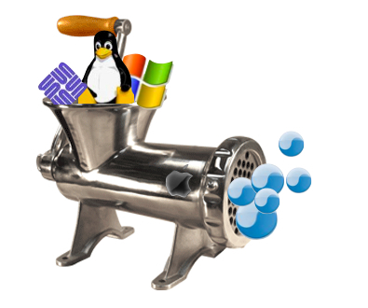
2. Reuse
http://www.roughlydrafted.com/2007/12/17/advancing-software-reuse-of-linux-windows-code-on-the-mac/

Slide 12
2.1 Introduction
Main goal:
Reuse knowledge from previous experience to current problem
Reuse functionality already available
Composition (also called Black Box Reuse)
New functionality is obtained by aggregation
The new object with more functionality is an aggregation of existing components
Inheritance (also called White-box Reuse)
New functionality is obtained by inheritance.
Three ways to get new functionality:
Implementation inheritance
Interface inheritance
Delegation

Slide 13
2.2 Reuse Heuristics
Look for existing classes in class libraries
JSAPI(Java Speech API), JTAPI(Java Telephony API), ....
Select data structures appropriate to the algorithms
Container classes
Arrays, lists, queues, stacks, sets, trees, ...
Define new internal classes and operations only if necessary
Complex operations defined in terms of lower-level operations might need new classes and operations

Slide 14
2.3 Reuse Concepts
Application objects versus solution objects
Specification inheritance and implementation inheritance
The Liskov Substitution Principle
Delegation
Delegation and inheritance in design patterns

Slide 15
(1) Application Domain vs Solution Domain Objects
Requirements Analysis
(Language of Application
Domain)
Object Design
(Language of Solution Domain)
Incident
Report
Incident
Report
Text box
Menu
Scrollbar
Do the two Incident Reports have the same meaning?

Slide 16
(2) Inheritance
Inheritance is used to achieve two different goals
Description of Taxonomies
Implementation Specification
Identification of taxonomies
Used during requirements analysis.
Activity: identify application domain objects that are hierarchically related
Goal: make the analysis model more understandable
Implementation specification
Used during object design
Activity:
Goal: increase reusability, enhance modifiability and extensibility
Inheritance is found either by specialization or generalization

Slide 17
Inheritance is used during analysis and object design
Object
Design
Inheritance
Analysis
activity
Taxonomy
Inheritance
for Reuse
Inheritance detected
Inheritance detected
Specification
Implementation
by specialization
by generalization
Inheritance
Inheritance

Slide 18
Taxonomy Example
Mammal
Tiger
Wolf
Wale

Slide 19
Specification Inheritance vs Implementation Inheritance
Specification inheritance
Also called subtyping
Inherit from an abstract class with all operations specified, but not yet implemented
Implementation inheritance
Also called class inheritance
Goal: Extend an applications’ functionality by reusing functionality in parent class
Inherit from an existing class with some or all operations already implemented

Slide 20
Implementation Inheritance
A very similar class is already implemented that does almost the same as the desired class implementation.
List
Example: I have a List class, I need a Stack class. How about subclassing the Stack class from the List class and providing three methods, Push() and Pop(), Top()?
Add
()
Remove()
“Already
implemented”
Stack
Push
()
Pop()
Top()
Problem with implementation inheritance:
Some of the inherited operations might exhibit unwanted behavior.
What happens if the Stack user calls Remove() instead of Pop()?
An elephant becomes a car!
Notes:
Inheritance is a generalization technique, in which the behavior of a superclass is shared by all its subclasses. Sometimes it is misused as an implementation technique.
Question: Can you give me an example for unwanted behavior?

Slide 21
(3) Delegation as alternative to Implementation Inheritance
In Delegation two objects are involved in handling a request
A receiving object delegates operations to its delegate.
The developer can make sure that the receiving object does not allow the client to misuse the delegate object
Client
Receiver
Delegate
calls
Delegates to

Slide 22
Delegation instead of Implementation Inheritance
Inheritance: Extending a Base class by a new operation or overwriting an operation.
Delegation: Catching an operation and sending it to another object.
Which of the following models is better for implementing a stack?
List
Stack
List
+Add()
+Remove()
Remove()
+Push()
+Pop()
+Top()
Add()
Stack
+Push()
+Pop()
+Top()

Slide 23
Object design model before transformation
Object design model after transformation
Hashtable
Hashtable
put(key,element)
put(key,element)
get(key):Object
get(key):Object
containsKey(key):boolean
containsKey(key):boolean
containsValue(element):boolean
containsValue(element):boolean
table
1
1
MySet
MySet
put(element)
put(element)
containsValue(element):boolean
containsValue(element):boolean

Slide 24
/* Implementation of MySet using inheritance */
class MySet extends Hashtable {
/* Constructor omitted */
MySet() {
}
void put(Object element) {
if (!containsKey(element)){
put(element, this);
}
}
boolean containsValue(Object
element){
return containsKey(element);
}
/* Other methods omitted */
}
/* Implementation of MySet using delegation */
class MySet {
private Hashtable table;
MySet() {
table = Hashtable();
}
void put(Object element) {
if (!containsValue(element)){
table.put(element,this);
}
}
boolean containsValue(Object
element) {
return
(table.containsKey(element));
}
/* Other methods omitted */
}

Slide 25
Comparison: Delegation vs Implementation Inheritance
Delegation
Pro:
Flexibility: Any object can be replaced at run time by another one (as long as it has the same type)
Con:
Inefficiency: Objects are encapsulated.
Inheritance
Pro:
Straightforward to use
Supported by many programming languages
Easy to implement new functionality
Con:
Inheritance exposes a subclass to the details of its parent class
Any change in the parent class implementation forces the subclass to change (which requires recompilation of both)
why?

Slide 26
(4) The Liskov Substitution Principle
If an object of type S can be substituted in all the places where an object of type T is expected, then S is a subtype of T
100 Percentage Principle
IS-A Principle

Slide 27
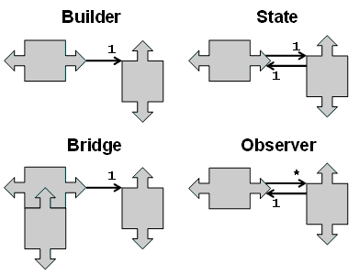
3. Design Patterns

Slide 28
Finding Objects
The hardest problems in object-oriented system development are:
Identifying objects
Decomposing the system into objects
Requirements Analysis focuses on application domain:
Object identification
System Design addresses both, application and implementation domain:
Subsystem Identification
Object Design focuses on implementation domain:
Additional solution objects

Slide 29
Techniques for Finding Objects
Requirements Analysis
Start with Use Cases. Identify participating objects
Textual analysis of flow of events (find nouns, verbs, ...)
Extract application domain objects by interviewing client (application domain knowledge)
Find objects by using general knowledge
System Design
Subsystem decomposition
Try to identify layers and partitions
Object Design
Find additional objects by applying implementation domain knowledge

Slide 30
Another Source for Finding Objects : Design Patterns
What are Design Patterns?
A design pattern describes a problem which occurs over and over again in our environment
Then it describes the core of the solution to that problem, in such a way that you can use the this solution a million times over, without ever doing it the same twice

Slide 31
Patterns of Learning
Successful solutions to many areas of human endeavor are deeply rooted in patterns
In fact, an important goal of education is transmitting patterns of leaning from generation to generation
Below, we’ll explore how patterns are used to learn chess
Learning to develop good software is similar to leaning to play good chess
Though the consequences of failure are often far less dramatic

Slide 32
Becoming a Chess Master
First lean rules and physical requirements
e.g., names of pieces, legal movements, chess board geometry and orientation, etc.
Then lean principles
e.g., relative value of certain pieces, strategic value of center squares, power of a threat, etc.
However, to become a master of chess, one must study the games of other masters
These games contains patterns that must be understood, memorized, and applied repeatedly
There are hundreds of these patterns

Slide 33
Becoming a Software Design Master
First learn the rules
e.g., the algorithms, data structures and languages of software
Then learn the principles
e.g., structured programming, modular programming, object oriented programming, generic programming, etc.
However, to truly master software design, one must study the designs of other masters
– These designs contain patterns must be understood, memorized, and applied repeatedly
There are hundreds of these patterns

Slide 34
Example
To represent a Software System
A software system consists of subsystems which are either other subsystems or collection of classes
To represent the Software Lifecycle:
The software lifecycle consists of a set of development activities which are either other activities or collection of tasks

Slide 35
Introducing the Composite Pattern
Models tree structures that represent part-whole hierarchies with arbitrary depth and width.
The Composite Pattern lets client treat individual objects and compositions of these objects uniformly
Client
Component
Leaf
Operation()
Composite
Operation()
AddComponent
RemoveComponent()
GetChild()
Children

Slide 36
What is common between these definitions?
Software System:
Definition: A software system consists of subsystems which are either other subsystems or collection of classes
Composite: Subsystem (A software system consists of subsystems which consists of subsystems , which consists of subsystems, which...)
Leaf node: Class
Software Lifecycle:
Definition: The software lifecycle consists of a set of development activities which are either other activities or collection of tasks
Composite: Activity (The software lifecycle consists of activities which consist of activities, which consist of activities, which....)
Leaf node: Task

Slide 37
Modeling a Software System with a Composite Pattern
User
Software
System
*
Class
Subsystem
Children

Slide 38
Modeling the Software Lifecycle with a Composite Pattern
Manager
Software
Lifecycle
*
Task
Activity
Children

Slide 39
The Composite Patterns models dynamic aggregates
Fixed Structure:
Car
*
*
Doors
Wheels
Battery
Engine
Organization Chart (variable aggregate):
*
*
Department
University
School
Composite
Pattern
Dynamic tree (recursive aggregate):
Program
Dynamic tree (recursive aggregate):
*
*
Block
Compound
Simple
Statement
Statement
Notes:
What you are seeing on this slide are what I would like to call patterns for analysis.
A pattern is a recurring theme, something once you get used to see something this way, allows you to very fast understand a situation.
It is well known, that if you show a set of chess positions of middle games tochess masters and non chess players, that chess masters are able to reconstruct these games without any effort.
However, if you give them random chess configurations, chess masters are about as bad as non-chess players in reconstructing the boards.
This tells you about the value of patterns. I would like you to learn about these aggregation patterns. In fact, I challenge you to see for your team and subsystem, if any of the analysis problems you face, can be cast in terms of one of the 3 patterns above.

Slide 40
Graphic Applications also use Composite Patterns
The Graphic Class represents both primitives (Line, Circle) and their containers (Picture)
Client
Graphic
Line
Draw()
Circle
Draw()
Picture
Draw()
Add(Graphic g)
RemoveGraphic)
GetChild(int)
Children

Slide 41
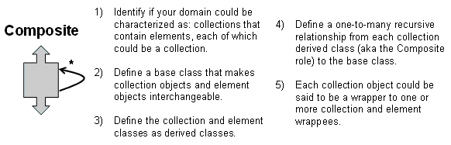

Slide 42
Example: A More Complex Model of a Software Project
Taxonomies
Basic Abstractions
Composite Patterns
Notes:
This model is already much more complex than the model shown on the previous slide. Its purpose is still for communication only.
Because it already has quite a number of abstractions, It can only be understood if we communicate the model well to the user. We can do this by navigating through the model and highlight basic abstractions and typical patterns.
For example, we can highlight the basic abstraction (the ones used in the previous slide) <<Proceed to first animation>> and tell the listener that these are the abstraction used in the previous slide (to make the point more clear, the instructor can move once more to the previous slide)
To reduce the complexity of the model, the instructor can then point out that Work Product, Task and Participant all are now basic leaves in a composite pattern. <<Proceed to the next animation, show the use of the composite patterns>>.
To reduce the complexity even further, the instructor finally points out the use of inheritance for the taxonomies (Resource, Staff, Work Product and Activity)
Given these three tips, the students should be able to understand the model themselves.

Slide 43
Benefits
Patterns explicitly capture expert knowledge and design tradeoffs, and make this expertise more widely available.
Patterns help improve developer communication.
– Pattern names form a vocabulary
Patterns help ease the transition to object-oriented technology.

Slide 44
Some Points
Do not recast everything as a pattern.
– Instead, develop strategic domain patterns and reuse existing tactical patterns.
Directly involve Pattern Authors with Application Developers and Domain Experts.
Clearly document when patterns apply and do not apply.

Slide 45
Towards a Pattern Taxonomy
Structural Patterns
Adapters, Bridges, Facades, and Proxies are variations on a single theme:
They reduce the coupling between two or more classes
They introduce an abstract class to enable future extensions
They encapsulate complex structures
Behavioral Patterns
Here we are concerned with algorithms and the assignment of responsibilities between objects: Who does what?
Behavioral patterns allow us to characterize complex control flows that are difficult to follow at runtime.
Creational Patterns
Here our goal is to provide a simple abstraction for a complex instantiation process.
We want to make the system independent from the way its objects are created, composed and represented.

Slide 46
A Pattern Taxonomy
Pattern
Creational
Pattern
Structural
Pattern
Behavioral
Pattern
Abstract
Factory
Builder
Pattern
Command
Command
Observer
Strategy
Adapter
Bridge
Facade
Proxy
Composite

Slide 47
Adapter pattern
Client
ClientInterface
Request()
LegacyClass
ExistingRequest()
adaptee
Adapter
Request()
Delegation is used to bind an Adapter and an Adaptee
Interface inheritance is use to specify the interface of the Adapter class.
Target and Adaptee (usually called legacy system) pre-exist the Adapter.

Slide 48
Adapter Pattern
“Convert the interface of a class into another interface clients expect.”
The adapter pattern lets classes work together that couldn‘t otherwise because of incompatible interfaces
Used to provide a new interface to existing legacy components (Interface engineering, reengineering).
Also known as a wrapper
Two adapter patterns:
Class adapter:
Uses multiple inheritance to adapt one interface to another
Object adapter:
Uses single inheritance and delegation
Object adapters are much more frequent. We will only cover object adapters (and call them therefore simply adapters)

Slide 49
<<interface>>
Adapters use interfaces and
ITaxCalculatorAdapter
polymorphism to add a level of
indirection to varying APIs in other
getTaxes( Sale ) : List of TaxLineItems
components.
TaxMasterAdapter
GoodAsGoldTaxPro
Adapter
getTaxes( Sale ) : List of TaxLineItems
getTaxes( Sale ) : List of TaxLineItems
<<interface>>
<<interface>>
IAccountingAdapter
ICreditAuthorizationService
postReceivable( CreditPayment )
Adapter
postSale( Sale )
requestApproval(CreditPayment,TerminalID, MerchantID)
...
...
<<interface>>
IInventoryAdapter
SAPAccountingAdapter
GreatNorthernAccountingAdapter
...
postReceivable( CreditPayment )
postReceivable( CreditPayment )
postSale( Sale )
postSale( Sale )
...
...

Slide 50
UML notation to indicate something
implements a particular interface
:Register
: SAPAccountingAdapter
IAccountingAdapter
makePayment()
...
SOAP over
HTTP
postSale( sale )
xxx
<<system>>
: SAP
the Adapter adapts to
interfaces in other
components

Slide 51
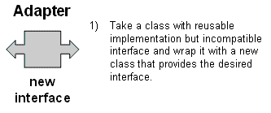
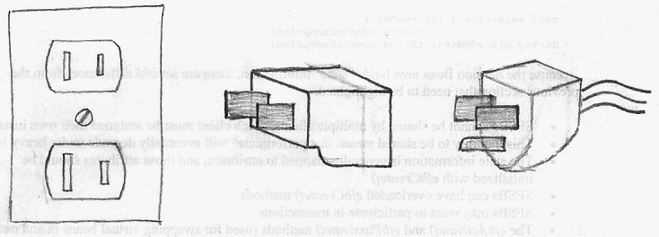
http://www.vincehuston.org/dp/adapter.html

Slide 52
Pattern
Creational
Pattern
Structural
Pattern
Behavioral
Pattern
Abstract
Factory
Builder
Pattern
Command
Command
Observer
Strategy
Adapter
Bridge
Facade
Proxy
Composite

Slide 53
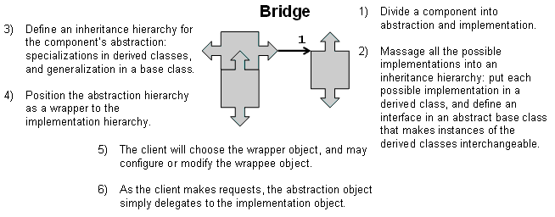
Bridge Pattern
Use a bridge to “decouple an abstraction from its implementation so that the two can vary independently”. (From [Gamma et al 1995])
Allows different implementations of an interface to be decided upon dynamically.

Slide 54
Using a Bridge
The bridge pattern is used to provide multiple implementations under the same interface.
Examples: Interface to a component that is incomplete, not yet known or unavailable during testing

Slide 55
/** "Implementor" */
interface DrawingAPI {
public void drawCircle(double x, double y, double radius); }
/** "ConcreteImplementor" 1/2 */
class DrawingAPI1 implements DrawingAPI {
public void drawCircle(double x, double y, double radius) {
System.out.printf("API1.circle at %f:%f radius %f\n", x, y, radius);
} }
/** "ConcreteImplementor" 2/2 */
class DrawingAPI2 implements DrawingAPI {
public void drawCircle(double x, double y, double radius) {
System.out.printf("API2.circle at %f:%f radius %f\n", x, y, radius);
} }

Slide 56
/** "Abstraction" */
abstract class Shape {
protected DrawingAPI drawingAPI;
protected Shape(DrawingAPI drawingAPI){
this.drawingAPI = drawingAPI; }
public abstract void draw(); // low-level
public abstract void resizeByPercentage(double pct); // high-level
}
/** "Refined Abstraction" */
class CircleShape extends Shape {
private double x, y, radius;
public CircleShape(double x, double y, double radius, DrawingAPI drawingAPI) {
super(drawingAPI);
this.x = x; this.y = y; this.radius = radius; }
// low-level i.e. Implementation specific
public void draw() {
drawingAPI.drawCircle(x, y, radius); }
// high-level i.e. Abstraction specific
public void resizeByPercentage(double pct) {
radius *= pct;
}}

Slide 57
class BridgePattern {
public static void main(String[] args) {
Shape[] shapes = new Shape[] {
new CircleShape(1, 2, 3, new DrawingAPI1()),
new CircleShape(5, 7, 11, new DrawingAPI2()),
};
for (Shape shape : shapes) {
shape.resizeByPercentage(2.5);
shape.draw();
}
}
}

Slide 58
Adapter vs Bridge
Similarities:
Both are used to hide the details of the underlying implementation.
Difference:
The adapter pattern is geared towards making unrelated components work together
Applied to systems after they’re designed (reengineering, interface engineering).
A bridge, on the other hand, is used up-front in a design to let abstractions and implementations vary independently.
Green field engineering of an “extensible system”
New “beasts” can be added to the “object zoo”, even if these are not known at analysis or system design time.
A bridge is by design. An adaptor is not. An adaptor is a patch. A bridge is put in place on purpose.

Slide 59
Pattern
Creational
Pattern
Structural
Pattern
Behavioral
Pattern
Abstract
Factory
Builder
Pattern
Command
Command
Observer
Strategy
Adapter
Bridge
Facade
Proxy
Composite

Slide 60
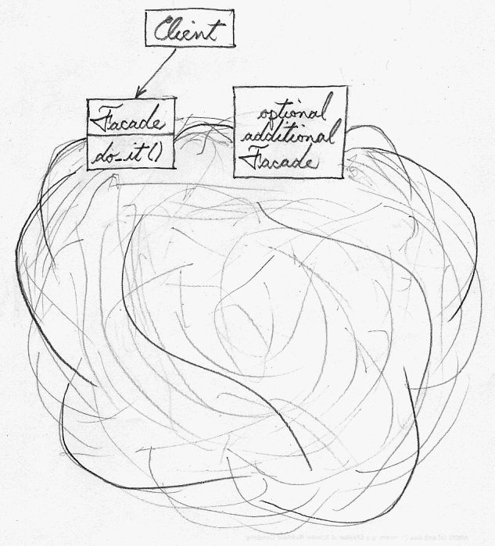
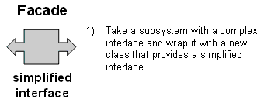
Facade Pattern
Provides a unified interface to a set of objects in a subsystem.
A facade defines a higher-level interface that makes the subsystem easier to use (i.e. it abstracts out the gory details)
Facades allow us to provide a closed architecture
http://www.vincehuston.org/dp/facade.html

Slide 61
Design Example
Subsystem 1 can look into the Subsystem 2 (vehicle subsystem) and call on any component or class operation at will.
This is “Ravioli Design”
Why is this good?
Efficiency
Why is this bad?
Can’t expect the caller to understand how the subsystem works or the complex relationships within the subsystem.
We can be assured that the subsystem will be misused, leading to non-portable code
Subsystem 1
Subsystem 2
Seat
Card
AIM
SA/RT

Slide 62
Realizing an Opaque Architecture with a Facade
VIP Subsystem
The subsystem decides exactly how it is accessed.
No need to worry about misuse by callers
If a façade is used the subsystem can be used in an early integration test
We need to write only a driver
Vehicle Subsystem API
Seat
Card
AIM
SA/RT

Slide 63
Consider a customer applying for a bank loan. Now the bank has various departments like Address Verification Department, Finance Verification department and many more. Our task is to write an application which will check whether the customer qualifies for a loan or not.
Our application will have the following classes: Customer, Bank, AddressVerifier, SalaryVerifer.

Slide 64
Customer c = new Customer();
AddressVerifier objAddressVerifier = new AddressVerifier();
bool isAddressVerified=objAddressVerifier.HasProperAddress(c);
FinanceVerifier objFinanceVerifier = new FinanceVerifier();
bool hasGoodSalary = objFinanceVerifier.HasGoodSalary(c);
bool hasAnyOtherLoan = objFinanceVerifier.HaveAnyOtherLoan(c);
if(isAddressVerified && hasGoodSalary && !hasAnyOtherLoan)
{
Console.WriteLine("Loan Approved");
}
else
{
Console.WriteLine("Loan Rejected");
} The Client code has become very complex.

Slide 65
public class LoanFascade
{
public bool doApplicableForLoan(Customer c)
{
AddressVerifier objAddressVerifier = new AddressVerifier();
bool isAddressVerified = objAddressVerifier.HasProperAddress(c);
FinanceVerifier objFinanceVerifier = new FinanceVerifier();
bool hasGoodSalary = objFinanceVerifier.HasGoodSalary(c);
bool hasAnyOtherLoan = objFinanceVerifier.HaveAnyOtherLoan(c);
return (isAddressVerified && hasGoodSalary && !hasAnyOtherLoan);
}
} Client Code
Customer c = new Customer();
LoanFascade objLoanFascade=new LoanFascade();
if(objLoanFascade.doApplicableForLoan(c))
{ Console.WriteLine("Loan Approved"); }
else
{ Console.WriteLine("Loan Rejected"); }

Slide 66
Subsystem Design with Façade, Adapter, Bridge
The ideal structure of a subsystem consists of
an interface object
a set of application domain objects (entity objects) modeling real entities or existing systems
Some of the application domain objects are interfaces to existing systems
one or more control objects
We can use design patterns to realize this subsystem structure
Realization of the Interface Object: Facade
Provides the interface to the subsystem
Interface to existing systems: Adapter or Bridge
Provides the interface to existing system (legacy system)
The existing system is not necessarily object-oriented!

Slide 67
Pattern
Creational
Pattern
Structural
Pattern
Behavioral
Pattern
Abstract
Factory
Builder
Pattern
Command
Command
Observer
Strategy
Adapter
Bridge
Facade
Proxy
Composite

Slide 68
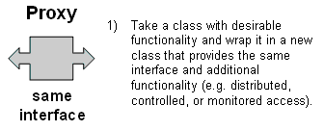
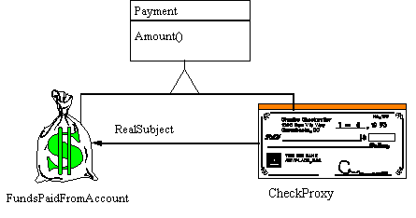
Proxy Pattern: Motivation
It is 15:00pm. I am sitting at my 14.4 baud modem connection and retrieve a fancy web site from the US, This is prime web time all over the US. So I am getting 10 bits/sec.
What can I do?
http://www.vincehuston.org/dp/proxy.html

Slide 69
Proxy Pattern
What is expensive?
Object Creation
Object Initialization
Defer object creation and object initialization to the time you need the object
Proxy pattern:
Reduces the cost of accessing objects
Uses another object (“the proxy”) that acts as a stand-in for the real object
The proxy creates the real object only if the user asks for it

Slide 70
Proxy pattern
Subject
Request()
Proxy
Request()
RealSubject
Request()
realSubject
Interface inheritance is used to specify the interface shared by Proxy and RealSubject.
Delegation is used to catch and forward any accesses to the RealSubject (if desired)
Proxy patterns can be used for lazy evaluation and for remote invocation.
Proxy patterns can be implemented with a Java interface.

Slide 71
Proxy Applicability
Remote Proxy
Local representative for an object in a different address space
Caching of information: Good if information does not change too often
Virtual Proxy
Object is too expensive to create or too expensive to download
Protection Proxy
Proxy provides access control to the real object
Useful when different objects should have different access and viewing rights for the same document.
Example: Grade information for a student shared by administrators, teachers and students.

Slide 72
Virtual Proxy example
Image
boundingBox()
draw()
ProxyImage
boundingBox()
draw()
RealImage
boundingBox()
draw()
realSubject
Images are stored and loaded separately from text
If a RealImage is not loaded a ProxyImage displays a grey rectangle in place of the image
The client cannot tell that it is dealing with a ProxyImage instead of a RealImage
A proxy pattern can be easily combined with a Bridge

Slide 73
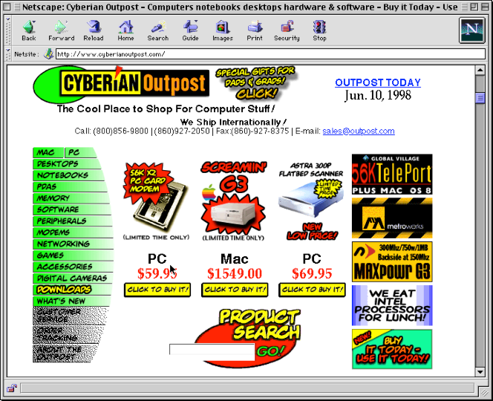
Before

Slide 74
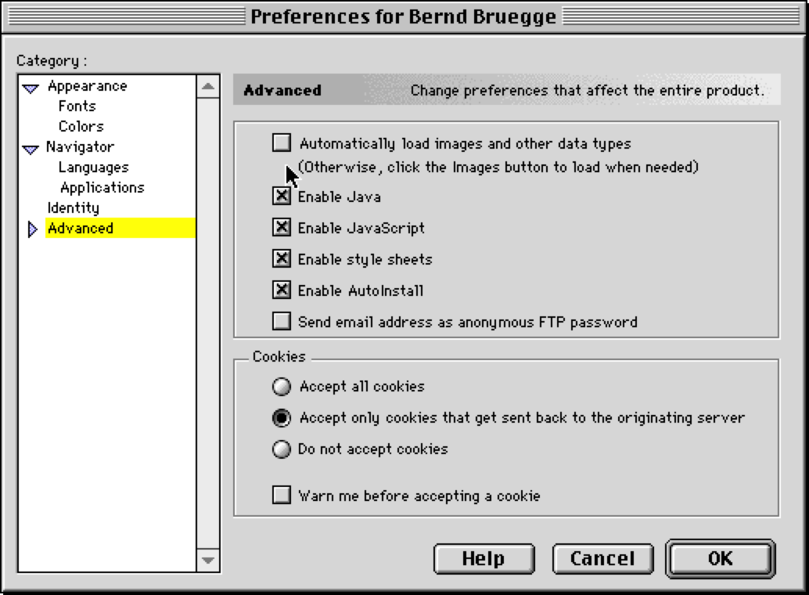
Controlling Access

Slide 75
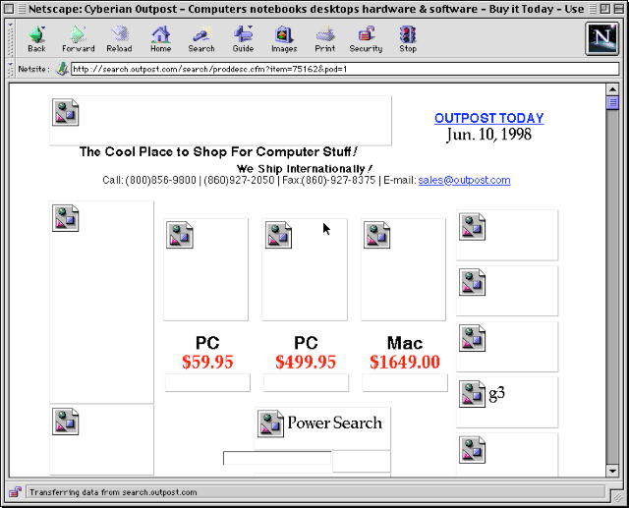
After

Slide 76
Pattern
Creational
Pattern
Structural
Pattern
Behavioral
Pattern
Abstract
Factory
Builder
Pattern
Command
Command
Observer
Strategy
Adapter
Bridge
Facade
Proxy
Composite

Slide 77
Observer pattern
“Define a one-to-many dependency between objects so that when one object changes state, all its dependents are notified and updated automatically.”
Also called “Publish and Subscribe”
Uses:
Maintaining consistency across redundant state
Optimizing batch changes to maintain consistency

Slide 78
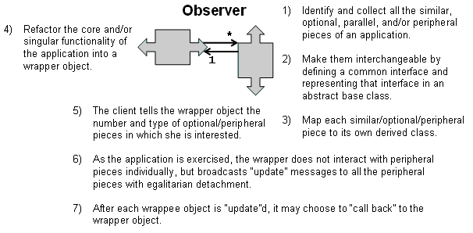
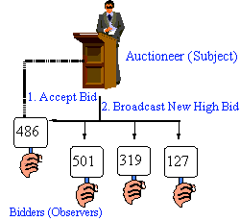

Slide 79
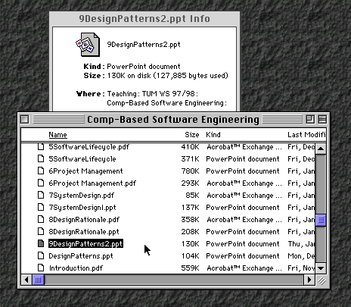
Observers
Subject
9DesignPatterns2.ppt

Slide 80
Subject
attach(observer)
detach(observer)
notify()
observers
*
Observer
update()
subject
ConcreteObserver
update()
observerState
ConcreteSubject
getState()
setState(newState)
subjectState
The Subject represents the actual state, the Observers represent different views of the state.
Observer can be implemented as a Java interface.
Subject is a super class (needs to store the observers vector) not an interface.

Slide 81
Sequence diagram for scenario: Change filename to “foo”
aFile
anInfoView
aListView
Attach()
Attach()
setState(“foo”)
Subject goes through all its
observers and calls update() on
them, asking for the new
state is decoupled from
the notification
notify()
update()
getState()
“foo”
update()

Slide 82
Animated Sequence diagram
aFile
anInfoView
aListView
Attach()
Attach()
setState(“foo”)
notify()
update()
update()
getState()
“foo”

Slide 83
Now, let us assume that we are building a sample stock market gadget app. Here, the subject is the one which has the 'stuff', i.e., the stock market quotes. The observers are different classes which display the latest stock quotes to the user.
Let us have classes representing the subject/observer relationship: the StockMarket class being the subject, and we have three different observer classes: GoogleStockGadget, YahooStockGadget, and MSNStockGadget.

Slide 84
public interface Subject
{
public void register(Observer o);
public void unregister(Observer o);
public void notify();
}
public interface Observer
{
public void update(int value);
}

Slide 85

public class StockMarket : Subject
{ // A Collection to keep track of all Registered Observers
ArrayList observers = new ArrayList();
// Stores latest stock quote (example is purposely simplistic)
int newValue = 0;
public void setValue(int v)
{ newValue = v; }
public void register(Observer o)
{ observers.add(o); }
public void unregister(Observer o)
{ int i = observers.indexOf(o);
observers.remove(i); }
public void notify()
{
for (int i=0;i < observers.size();i++)
{
Observer ob = (Observer)observers.get(i);
ob.update(newValue);
}
}
}

Slide 86
public class GoogleStockGadet : Observer
{
int latestValue = 0;
Subject stockMarket; // Subject reference variable
public GoogleStockGadet(Subject subject)
{ stockMarket = subject;
stockMarket.register(this);
// Registering itself to the Subject }
public void update(int value)
{ latestValue = value;
display(); }
public void display()
{
System.out.println("Latest Quote=" + latestValue);
}
public void unsubscribe()
{
stockMarket.unregister(this);
}
}

Slide 87
public class MainProgram
{
public static void Main(string[] args)
{
//Initialize Subject
StockMarket stockMarket = new StockMarket();
int latestQuote = 0;
// Initialize Gadgets..Note the subject being passed in Constructor
GoogleStockGadget googleGadget = new GoogleStockGadget(stockMarket);
MSNStockGadget msnGadget = new MSNStockGadget(stockMarket);
YahooStockGadget yahooGadget = new YahooStockGadget(stockMarket);

Slide 88
// Code for Getting latest stock
// ....
// ....
stockMarket.setValue(latestQuote);
// Updating all Registered Observers
stockMarket.notify();
//GoogleGadget decides to unregister/unsubscirbe
googleGadget.unsubscribe();
}
}

Slide 89
A Pattern Taxonomy
Pattern
Creational
Pattern
Structural
Pattern
Behavioral
Pattern
Abstract
Factory
Builder
Pattern
Command
Command
Observer
Strategy
Adapter
Bridge
Facade
Proxy
Composite

Slide 90
Command Pattern: Motivation
You want to build a user interface
You want to provide menus
You want to make the user interface reusable across many applications
You cannot hardcode the meanings of the menus for the various applications
The applications only know what has to be done when a menu is selected.
Such a menu can easily be implemented with the Command Pattern

Slide 91
Command pattern
Invoker
Command
execute()
Client
binds
Receiver
action()
ConcreteCommand
execute()
Client creates a ConcreteCommand and binds it with a Receiver.
Client hands the ConcreteCommand over to the Invoker which stores it.
The Invoker has the responsibility to do the command (“execute” or “undo”).

Slide 93
/* 主板的接口 */
public interface MainBoardApi {
/* 主板具有能开机的功能 */
public void open();
}
/*技嘉主板类，开机命令的真正实现者，在Command模式中充当Receiver
*/
public class GigaMainBoard implements MainBoardApi{
/*真正的开机命令的实现 */
public void open(){
System.out.println("技嘉主板现在正在开机，请等候");
System.out.println("接通电源......");
System.out.println("设备检查......");
System.out.println("装载系统......");
System.out.println("机器正常运转起来......");
System.out.println("机器已经正常打开，请操作");
}
}

Slide 94
/**
* 命令接口，声明执行的操作
*/
public interface Command {
/**
* 执行命令对应的操作
*/
public void execute();
}

Slide 95
/**
* 开机命令的实现，实现Command接口，
* 持有开机命令的真正实现，通过调用接收者的方法来实现命令
*/
public class OpenCommand implements Command{
/**
* 持有真正实现命令的接收者——主板对象
*/
private MainBoardApi mainBoard = null;
/**
* 构造方法，传入主板对象
* @param mainBoard 主板对象
*/
public OpenCommand(MainBoardApi mainBoard) {
this.mainBoard = mainBoard;
}
public void execute() {
//对于命令对象，根本不知道如何开机，会转调主板对象
//让主板去完成开机的功能
this.mainBoard.open();
}
}

Slide 96
**
* 机箱对象，本身有按钮，持有按钮对应的命令对象
*/
public class Box {
/**
* 开机命令对象
*/
private Command openCommand;
/**
* 设置开机命令对象
* @param command 开机命令对象
*/
public void setOpenCommand(Command command){
this.openCommand = command;
}
/**
* 提供给客户使用，接收并响应用户请求，相当于按钮被按下触发的方法
*/
public void openButtonPressed(){
//按下按钮，执行命令
openCommand.execute();
}
}

Slide 97
public class Client {
public static void main(String[] args) {
//1：把命令和真正的实现组合起来，相当于在组装机器，
//把机箱上按钮的连接线插接到主板上。
MainBoardApi mainBoard = new GigaMainBoard();
OpenCommand openCommand = new OpenCommand(mainBoard);
//2：为机箱上的按钮设置对应的命令，让按钮知道该干什么
Box box = new Box();
box.setOpenCommand(openCommand);
//3：然后模拟按下机箱上的按钮
box.openButtonPressed();
}
}

Slide 98
技嘉主板现在正在开机，请等候
接通电源......
设备检查......
装载系统......
机器正常运转起来......
机器已经正常打开，请操作
以上案例来自http://www.cnblogs.com/sjms/archive/2010/07/09/1774069.html

Slide 99
Command pattern Applicability
“Encapsulate a request as an object, thereby letting you
parameterize clients with different requests,
queue or log requests, and
support undoable operations.”
Uses:
Undo queues
Database transaction buffering

Slide 100
Pattern
Creational
Pattern
Structural
Pattern
Behavioral
Pattern
Abstract
Factory
Builder
Pattern
Command
Command
Observer
Strategy
Adapter
Bridge
Facade
Proxy
Composite

Slide 101
Strategy Pattern
Many different algorithms exists for the same task
Examples:
Breaking a stream of text into lines
Parsing a set of tokens into an abstract syntax tree
Sorting a list of customers
The different algorithms will be appropriate at different times
Rapid prototyping vs delivery of final product
We don’t want to support all the algorithms if we don’t need them
If we need a new algorithm, we want to add it easily without disturbing the application using the algorithm

Slide 102
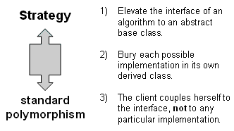
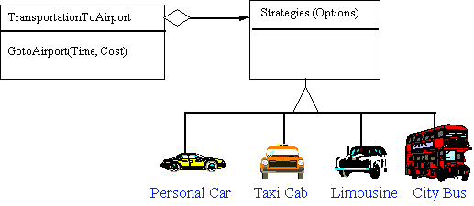
http://www.vincehuston.org/dp/strategy.html
Notes:
A Strategy defines a set of algorithms that can be used interchangeably. Modes of transportation to an airport is an example of a Strategy. Several options exist such as driving one's own car, taking a taxi, an airport shuttle, a city bus, or a limousine service. For some airports, subways and helicopters are also available as a mode of transportation to the airport. Any of these modes of transportation will get a traveler to the airport, and they can be used interchangeably. The traveler must chose the Strategy based on tradeoffs between cost, convenience, and time."

Slide 103
Strategy Pattern
Policy
Context
ContextInterface()
*
Strategy
AlgorithmInterface
ConcreteStrategyA
AlgorithmInterface()
ConcreteStrategyB
AlgorithmInterface()
ConcreteStrategyC
AlgorithmInterface()
Policy decides which Strategy is best given the current Context

Slide 104
Applying a Strategy Pattern in a Database Application
Database
Search()
Sort()
Strategy
*
Strategy
Sort()
BubbleSort
Sort()
QuickSort
Sort()
MergeSort
Sort()

Slide 105
http://blog.csdn.net/hguisu/article/details/7558249/

Slide 106
interface TravelStrategy{
public function travelAlgorithm();
}
/* 具体策略类(ConcreteStrategy)1：乘坐飞机 */
class AirPlanelStrategy implements TravelStrategy {
public function travelAlgorithm(){
echo "travel by AirPlain", "<BR>\r\n";
} }
/* 具体策略类(ConcreteStrategy)2：乘坐火车 */
class TrainStrategy implements TravelStrategy {
public function travelAlgorithm(){
echo "travel by Train", "<BR>\r\n";
} }
/** * 具体策略类(ConcreteStrategy)3：骑自行车 */
class BicycleStrategy implements TravelStrategy {
public function travelAlgorithm(){
echo "travel by Bicycle", "<BR>\r\n";
} }

Slide 107
class PersonContext{
private $_strategy = null;
public function __construct(TravelStrategy $travel){
$this->_strategy = $travel;
}
/* 旅行 */
public function setTravelStrategy(TravelStrategy $travel){
$this->_strategy = $travel;
}
/* 旅行 */
public function travel(){
return $this->_strategy ->travelAlgorithm();
} }
// 乘坐火车旅行
$person = new PersonContext(new TrainStrategy());
$person->travel();
// 改骑自行车
$person->setTravelStrategy(new BicycleStrategy());
$person->travel();

Slide 108
Applicability of Strategy Pattern
Many related classes differ only in their behavior. Strategy allows to configure a single class with one of many behaviors
Different variants of an algorithm are needed that trade-off space against time. All these variants can be implemented as a class hierarchy of algorithms

Slide 109
Pattern
Creational
Pattern
Structural
Pattern
Behavioral
Pattern
Abstract
Factory
Builder
Pattern
Command
Command
Observer
Strategy
Adapter
Bridge
Facade
Proxy
Composite

Slide 110
Abstract Factory Motivation
2 Examples
Consider a user interface toolkit that supports multiple looks and feel standards such as Motif, Windows 95 or the finder in MacOS.
How can you write a single user interface and make it portable across the different look and feel standards for these window managers?
Consider a facility management system for an intelligent house that supports different control systems such as Siemens’ Instabus, Johnson & Control Metasys or Zumtobe’s proprietary standard.
How can you write a single control system that is independent from the manufacturer?

Slide 111
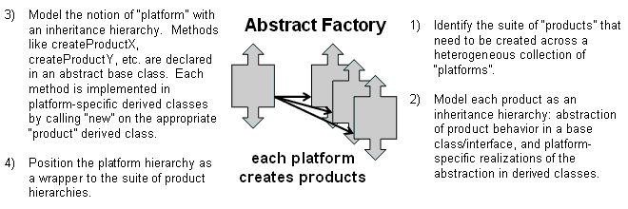

Slide 112
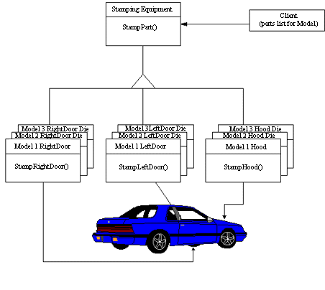

Slide 113
Abstract Factory
AbstractProductA
AbstractFactory
CreateProductA
CreateProductB
Client
ProductA1
ProductA2
CreateProductA
CreateProductB
AbstractProductB
ConcreteFactory1
ProductB1
ProductB2
ConcreteFactory2
CreateProductA
CreateProductB
Initiation Assocation:
Class ConcreteFactory2 initiates the
associated classes ProductB2 and ProductA2

Slide 114
Applicability for Abstract Factory Pattern
Independence from Initialization or Representation:
The system should be independent of how its products are created, composed or represented
Manufacturer Independence:
A system should be configured with one family of products, where one has a choice from many different families.
You want to provide a class library for a customer (“facility management library”), but you don’t want to reveal what particular product you are using.
Constraints on related products
A family of related products is designed to be used together and you need to enforce this constraint
Cope with upcoming change:
You use one particular product family, but you expect that the underlying technology is changing very soon, and new products will appear on the market.

Slide 115
Example: A Facility Management System for the Intelligent Workplace
IntelligentWorkplace
InitLightSystem
InitBlindSystem
InitACSystem
LightBulb
Facility
Mgt
System
InstabusLight
Controller
ZumbobelLight
Controller
Blinds
InitLightSystem
InitBlindSystem
InitACSystem
SiemensFactory
InstabusBlind
Controller
ZumtobelBlind
Controller
ZumtobelFactory
InitLightSystem
InitBlindsystem
InitACSystem

Slide 116
Pattern
Creational
Pattern
Structural
Pattern
Behavioral
Pattern
Abstract
Factory
Builder
Pattern
Command
Command
Observer
Strategy
Adapter
Bridge
Facade
Proxy
Composite

Slide 117
Builder Pattern Motivation
Conversion of documents
Software companies make their money by introducing new formats, forcing users to upgrades
But you don’t want to upgrade your software every time there is an update of the format for Word documents
Idea: A reader for RTF format
Convert RTF to many text formats (EMACS, Framemaker 4.0, Framemaker 5.0, Framemaker 5.5, HTML, SGML, WordPerfect 3.5, WordPerfect 7.0, ….)
Problem: The number of conversions is open-ended.
Solution
Configure the RTF Reader with a “builder” object that specializes in conversions to any known format and can easily be extended to deal with any new format appearing on the market

Slide 118
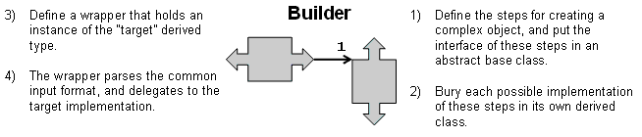

Slide 119
Builder Pattern
Construct()
BuildPart()
Director
Builder
For all objects in Structure {
Builder->BuildPart()
}
Represen-
tation B
BuildPart()
GetResult()
ConcreteBuilderB
BuildPart()
GetResult()
ConcreteBuilderA
Represen-
tation A

Slide 120
Example
Parse()
RTFReader
ConvertCharacter()
ConvertFontChange
ConvertParagraph()
TextConverter
While (t = GetNextToken()) {
Switch t.Type {
CHAR: builder->ConvertCharacter(t.Char)
FONT: bulder->ConvertFont(t.Font)
PARA: builder->ConvertParagraph
}
}
ConvertCharacter()
ConvertFontChange
ConvertParagraph()
GetASCIIText()
AsciiConverter
ConvertCharacter()
ConvertFontChange
ConvertParagraph()
GetASCIIText()
ConvertCharacter()
ConvertFontChange
ConvertParagraph()
GetASCIIText()
HTMLConverter
TexConverter
TeXText
AsciiText
HTMLText

Slide 121
When do you use the Builder Pattern?
The creation of a complex product must be independent of the particular parts that make up the product
In particular, the creation process should not know about the assembly process (how the parts are put together to make up the product)
The creation process must allow different representations for the object that is constructed. Examples:
A house with one floor, 3 rooms, 2 hallways, 1 garage and three doors.
A skyscraper with 50 floors, 15 offices and 5 hallways on each floor. The office layout varies for each floor.

Slide 122
Comparison: Abstract Factory vs Builder
Abstract Factory
Focuses on product family
The products can be simple (“light bulb”) or complex (“engine”)
Does not hide the creation process
The product is immediately returned
Builder
The underlying product needs to be constructed as part of the system, but the creation is very complex
The construction of the complex product changes from time to time
The builder patterns hides the creation process from the user:
The product is returned after creation as a final step
Abstract Factory and Builder work well together for a family of multiple complex products

Slide 123
What makes a design modifiable?
Low coupling and high cohesion
Clear dependencies
Explicit assumptions
How do design patterns help?
They are generalized from existing systems
They provide a shared vocabulary to designers
They provide examples of modifiable designs
Abstract classes
Delegation

Slide 124
Structural Patterns
Focus: How objects are composed to form larger structures
Problems solved:
Realize new functionality from old functionality,
Provide flexibility and extensibility
Behavioral Patterns
Focus: Algorithms and the assignment of responsibilities to objects
Problem solved:
Too tight coupling to a particular algorithm
Creational Patterns
Focus: Creation of complex objects
Problems solved:
Hide how complex objects are created and put together

Slide 125
Design patterns
Provide solutions to common problems.
Lead to extensible models and code.
Can be used as is or as examples of interface inheritance and delegation.
Apply the same principles to structure and to behavior.
Design patterns solve all your software engineering problems
My favorites: Composite, Bridge, Builder and Observer
?

Slide 126
4. Frameworks

Slide 127
Frameworks
A framework is a reusable partial application that can be specialized to produce custom applications.
Frameworks are targeted to particular technologies, such as data processing or cellular communications, or to application domains, such as user interfaces or real-time avionics.
The key benefits of frameworks are reusability and extensibility.
Reusability leverages of the application domain knowledge and prior effort of experienced developers
Extensibility is provided by hook methods, which are overwritten by the application to extend the framework.
Hook methods systematically decouple the interfaces and behaviors of an application domain from the variations required by an application in a particular context.
Are J2EE and the .NET framework frameworks or architectural specs?
Notes:
avionics
US: [ˌeɪviˈɑnɪks] UK: [ˌeɪviˈɒnɪks] 航空电子学;航空控制系统

Slide 128
Example: Framework for Building Web Applications
WebObjects
WebBrowser
WebServer
WebObjectsApplication
WOAdaptor
WORequest
WoRequest
Template
StaticHTML
EOF
RelationalDatabase

Slide 129
Classification of Frameworks
Frameworks can be classified by their position in the software development process.
Frameworks can also be classified by the techniques used to extend them.
Whitebox frameworks
Blackbox frameworks

Slide 130
Frameworks in the Development Process
Infrastructure frameworks aim to simplify the software development process
System infrastructure frameworks are used internally within a software project and are usually not delivered to a client.
Middleware frameworks are used to integrate existing distributed applications and components.
Examples: MFC, DCOM, Java RMI, WebObjects, WebSphere, WebLogic Enterprise Application [BEA].
Enterprise application frameworks are application specific and focus on domains
Example domains: telecommunications, avionics, environmental modeling, manufacturing, financial engineering, enterprise business activities.

Slide 131
White-box and Black-Box Frameworks
Whitebox frameworks:
Extensibility achieved through inheritance and dynamic binding.
Existing functionality is extended by subclassing framework base classes and overriding predefined hook methods
Often design patterns such as the template method pattern are used to override the hook methods.
Blackbox frameworks
Extensibility achieved by defining interfaces for components that can be plugged into the framework.
Existing functionality is reused by defining components that conform to a particular interface
These components are integrated with the framework via delegation.

Slide 132
Class libraries and Frameworks
Class Libraries:
Less domain specific
Provide a smaller scope of reuse.
Class libraries are passive; no constraint on control flow.
Framework:
Classes cooperate for a family of related applications.
Frameworks are active; affect the flow of control.
In practice, developers often use both:
Frameworks often use class libraries internally to simplify the development of the framework.
Framework event handlers use class libraries to perform basic tasks (e.g. string processing, file management, numerical analysis…. )

Slide 133
Components and Frameworks
Components
Self-contained instances of classes
Plugged together to form complete applications.
Blackbox that defines a cohesive set of operations,
Can be used based on the syntax and semantics of the interface.
Components can even be reused on the binary code level.
The advantage is that applications do not always have to be recompiled when components change.
Frameworks:
Often used to develop components
Components are often plugged into blackbox frameworks.

Slide 134
Component Selection
Select existing
off-the-shelf class libraries
frameworks or
components
Adjust the class libraries, framework or components
Change the API if you have the source code.
Use the adapter or bridge pattern if you don’t have access
Architecture Driven Design

Slide 135
Summary
Object design is the process of adding details to the requirements analysis and making implementation decisions
Three ways to get new functionality:
Implementation inheritance
Interface inheritance
Delegation
Patterns explicitly capture expert knowledge and design tradeoffs, and make this expertise more widely available.

Slide 136
Thanks cao-jian@cs.sjtu.edu.cn
The main materials come from Bernd Bruegge’s PPT, others from Internet

